Slide 1


The Battle of the Neighborhoods
CC YAN
AUG/20/2020

Slide 2

A safe and secure location for opening a Convenience Store in Vancouver, Canada
The first task would be to choose the safest borough by analyzing crime data for opening a convenience store and short listing a neighborhood, where convenience stores are not amongst the most common venues, and yet as close to the city as possible, especially in the living areas.
We will make use of our data science tools to analyze data and focus on the safest borough and explore its neighborhoods and the 10 most common venues in each neighborhood so that the best neighborhood where convenience store is not amongst the most common venue can be selected.

Slide 3

The data we need
Finding the safest borough based on crime statistics
Finding the most common venues
Choosing the right neighborhood within the borough

Slide 4
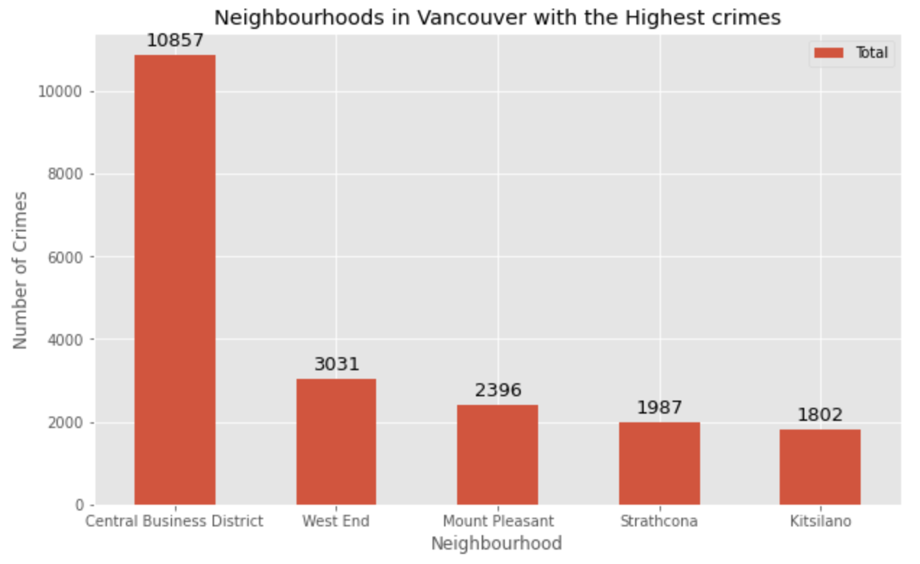
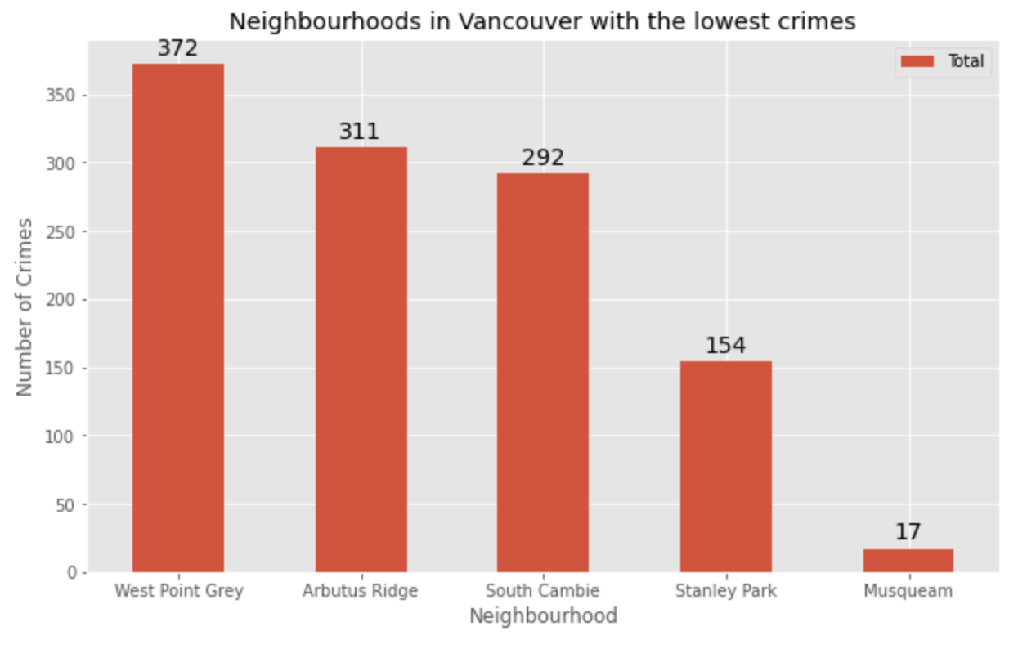
Exploratory data analyzes

Slide 5
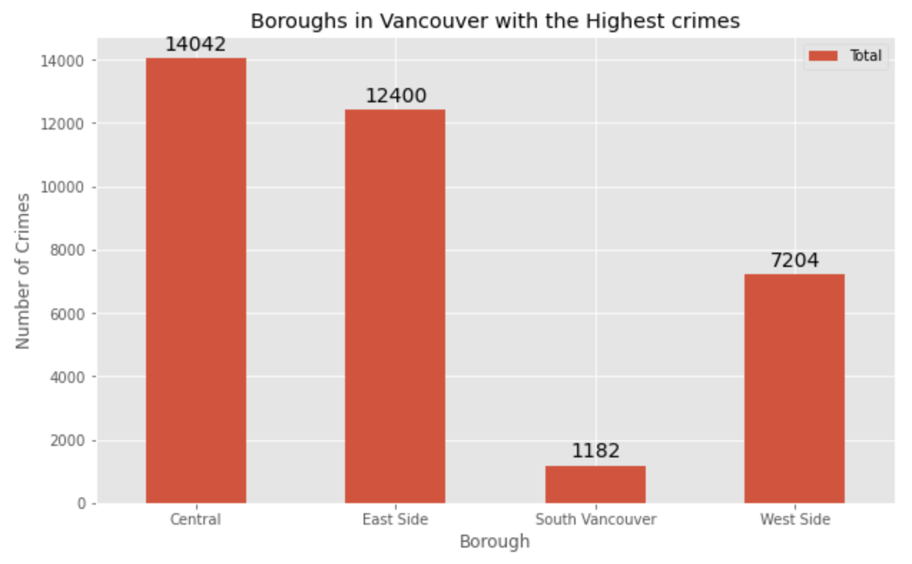
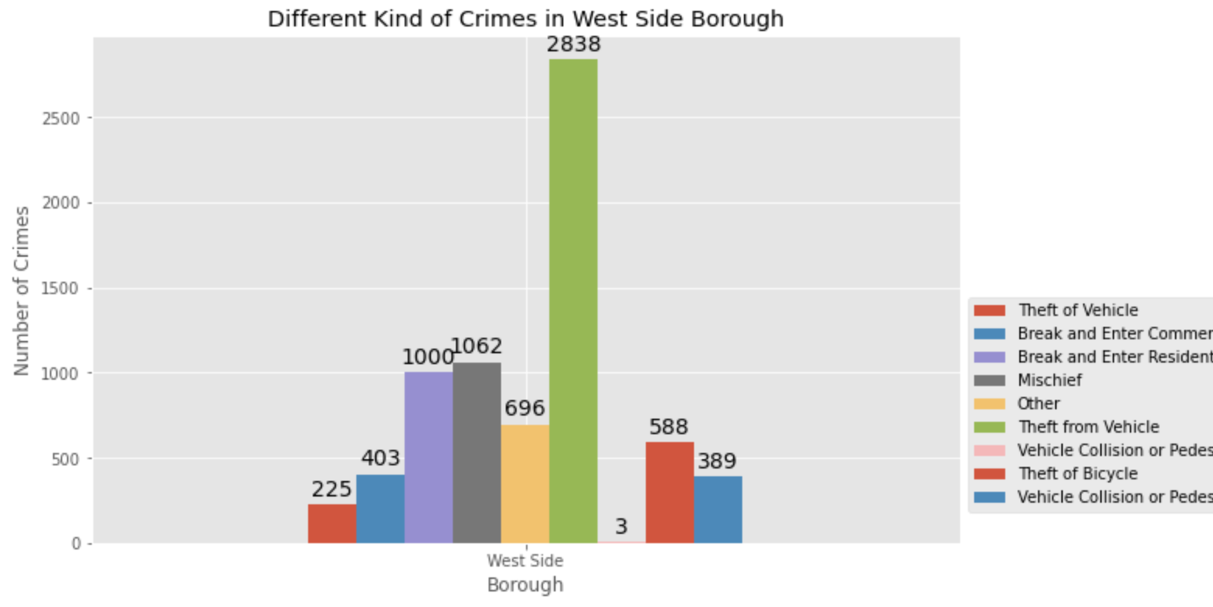
South Vancouver
the lowest crimes and very little number of neighborhoods
West Side
Enough neighborhoods

Slide 6
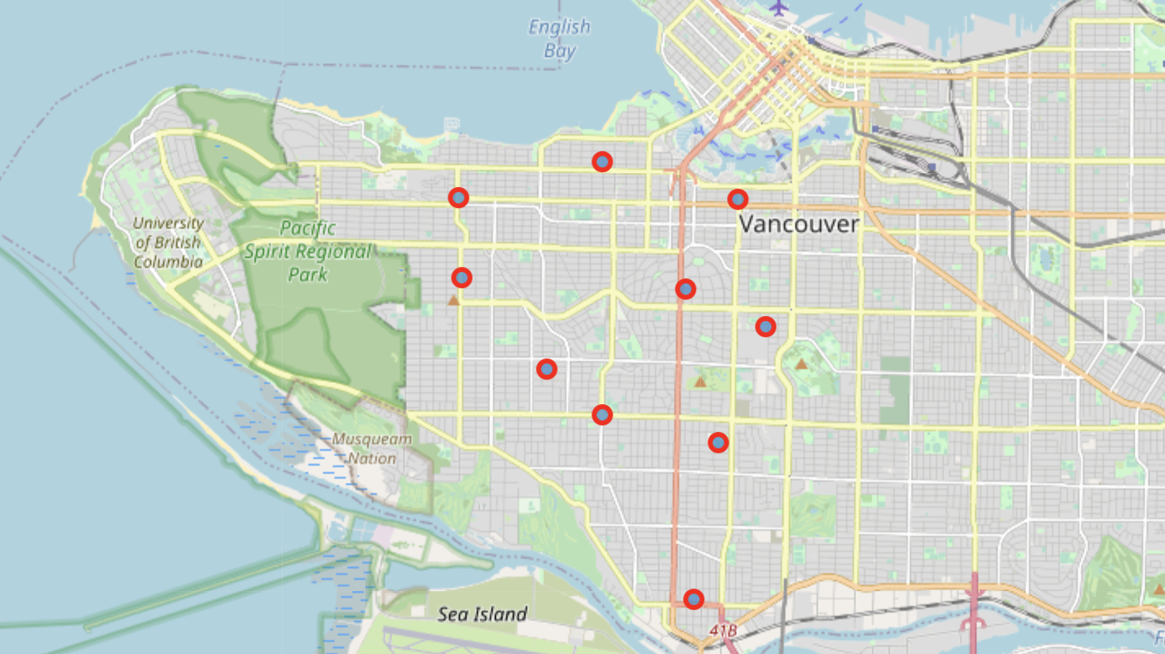
Use Folium to plot Vancouver City's West Side Borough and its Neighborhoods

Slide 7
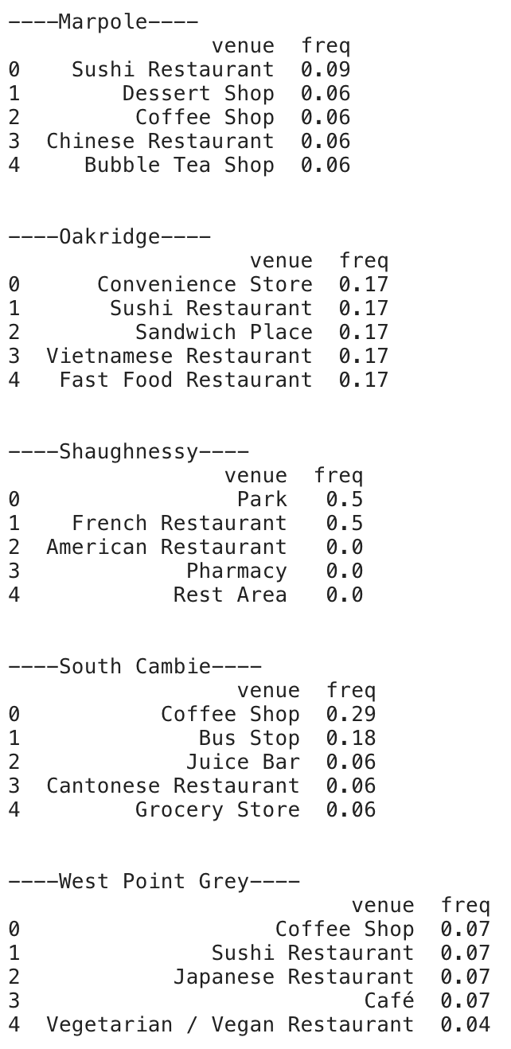
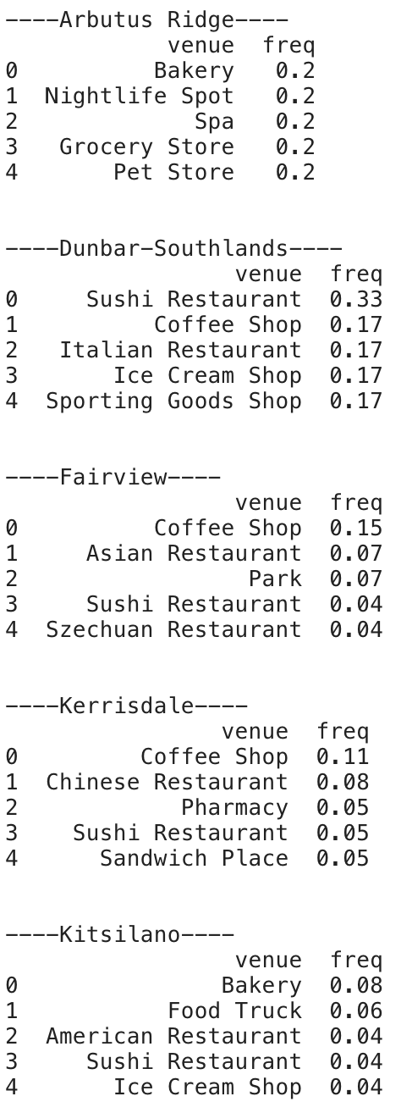
5 most common venues across neighborhoods

Slide 8
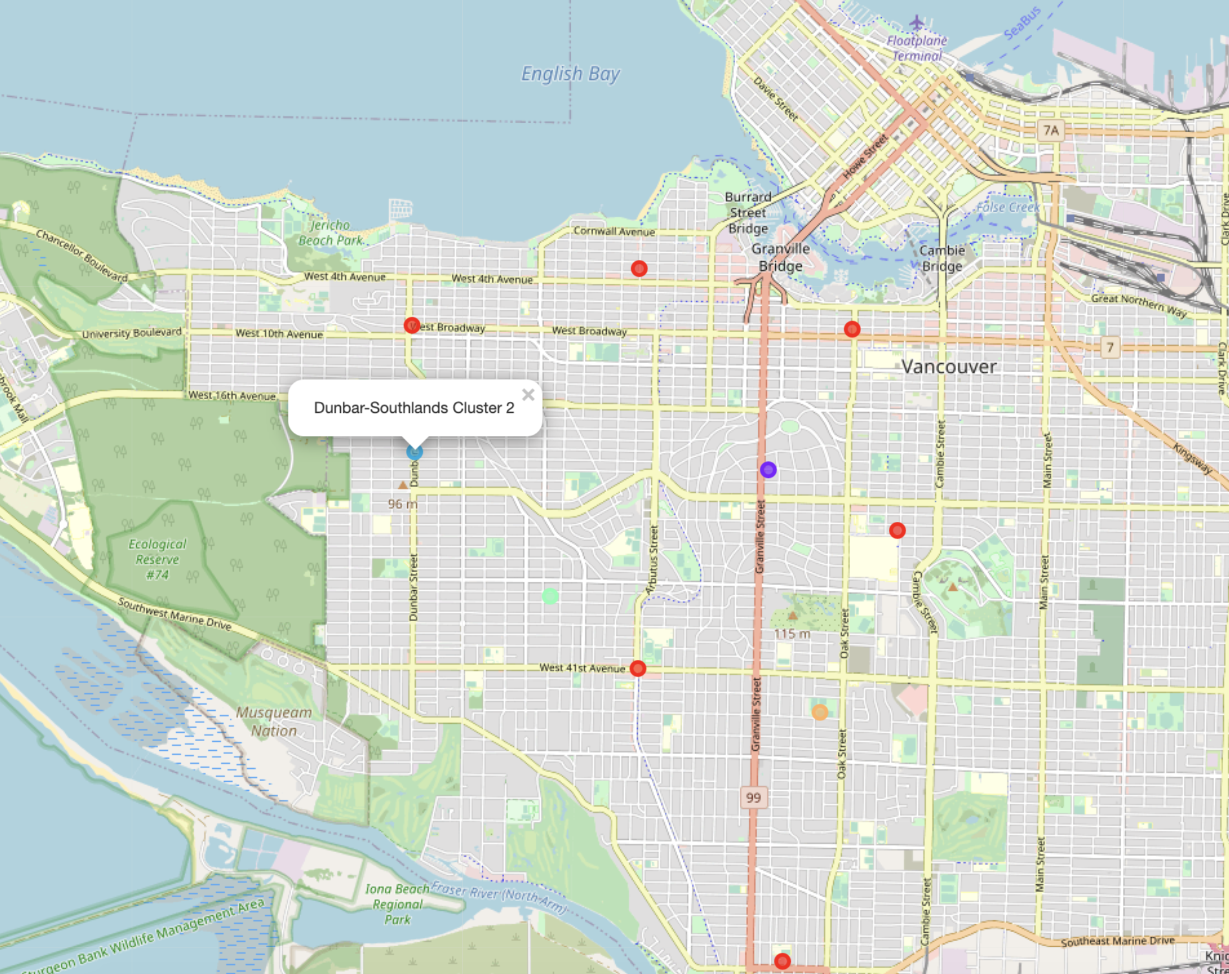

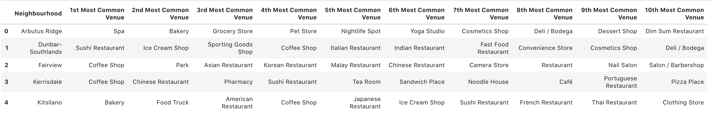
Modelling
K - means clustering

Slide 9

Conclusion Choose the right neighborhood where convenience store were not among venues close to each other.

Slide 10
THANK YOU !

